Slide 1
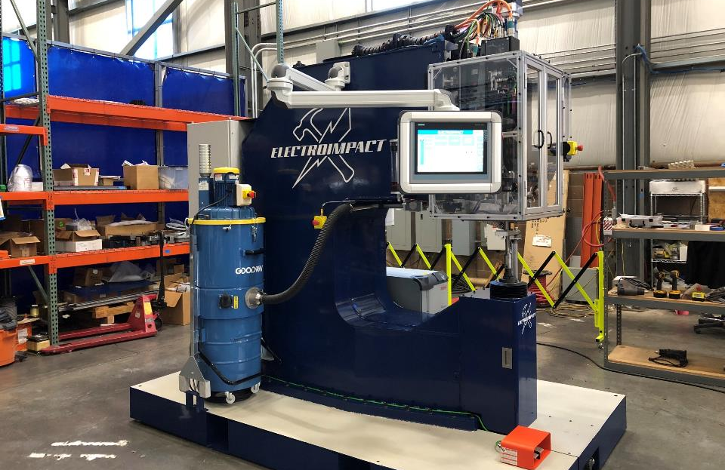
FlexRiveter Reliably Feeds Both Short (-4) And Long (Pintail)

Slide 2
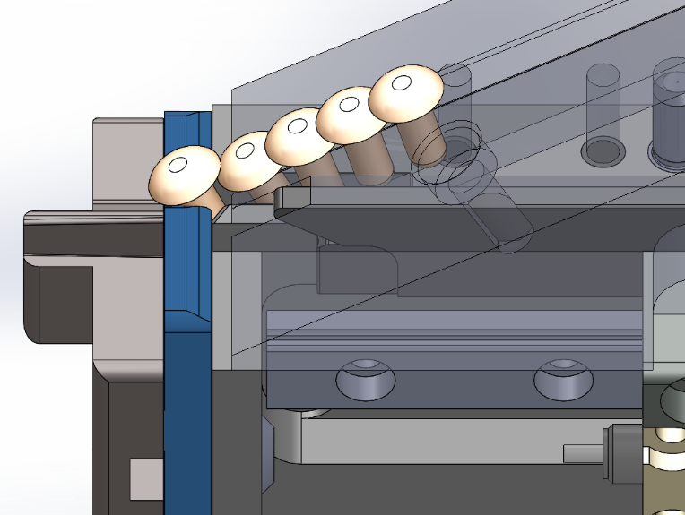
This Is A Typical Jam From A Hopper Due To Reverse Shingling
Slide cannot move because the tail of the reverse shingled fastener is blocking the slide path
Next fastener to be fed
is on top of the following
fastener in the track
(Reverse shingled)

Slide 3
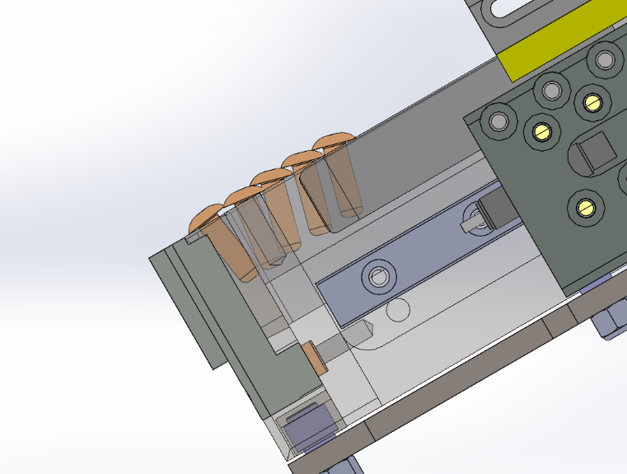
FlexRiveter Solves This Problem By Separating And Injecting At 30 Degrees
Next fastener to be fed
is on top of the following
fastener in the track
(Reverse shingled)
The constant angle of the track and slide is much more tolerant to the tipped tails of reverse shingled fasteners

Slide 4
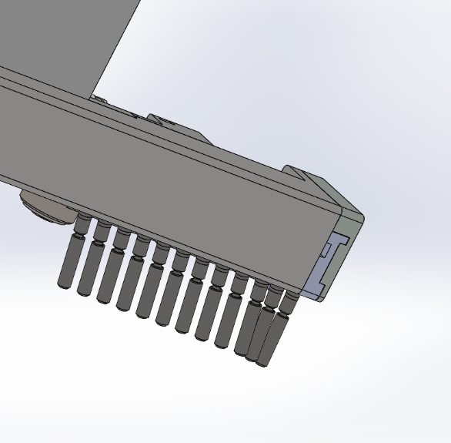
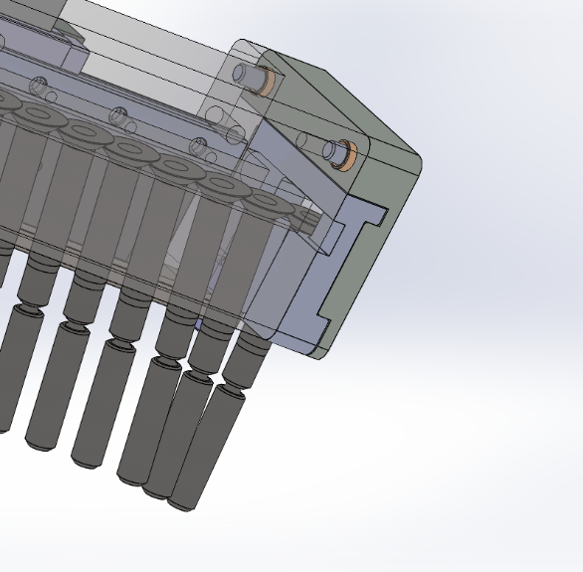
FlexRiveter Uses 30 Degree Hanger Feed For Long Length Fasteners
30 degree hanger design allows for feeding of virtually unlimited length fasteners

Slide 5
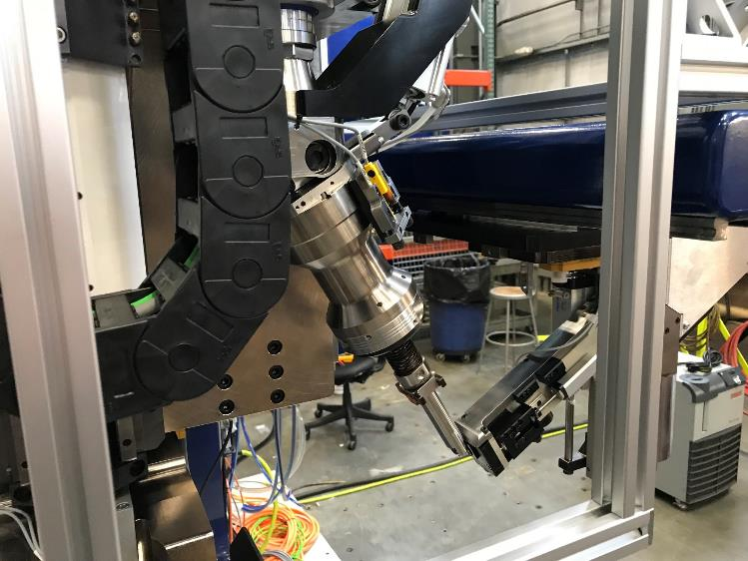
Rivets And Bolts Transfer Directly To The Fingers Without A Track Due To The Bent Knee Which Brings The Fingers To The Hopper
Patented bent knee riveter
Hopper slide mount as many as you want. Can be ball-screw actuated.
Patented air gap sensor
Upper tool auto drawbar

Slide 6
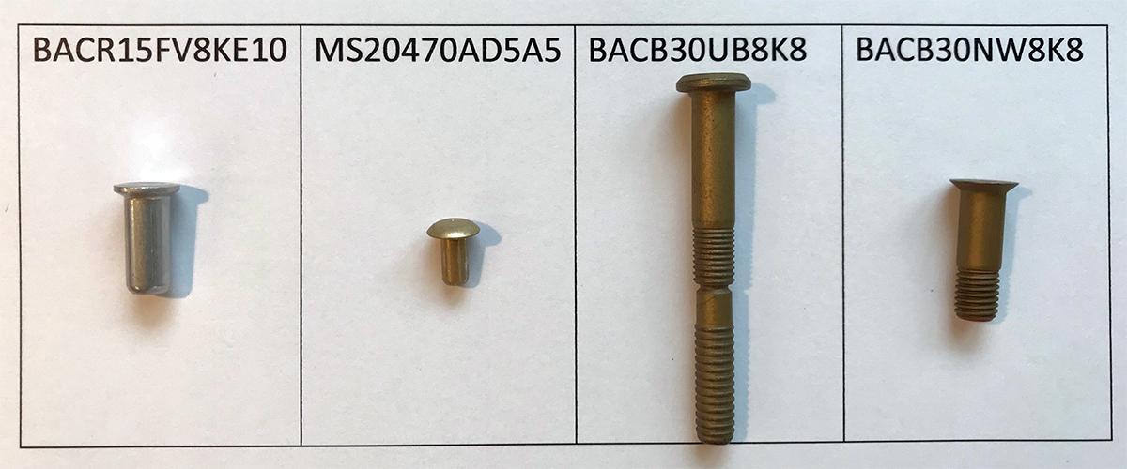
All Of These Can Be Reliably Fed And Installed. Tool Change Takes Seconds.

